Slide 1
The Modern Software Developer
CS146S
Stanford University, Fall 2026
Mihail Eric
themodernsoftware.dev

Slide 2
Logistics
OSS Partner assignments out tonight
  AI slop gets a 0
Project Proposals due tonight
Ashley Jepson (Factory) giving a workshop
themodernsoftware.dev

Slide 3
MCP, Tool-calling, and Beyond
themodernsoftware.dev
Notes:
Which brings us to this course…

Slide 4
Why
LLMs have vast (but static) world knowledge that only updates when we retrain
To build fully autonomous systems we need robust ways to feed dynamic data in
themodernsoftware.dev

Slide 5
MCP
Model Context Protocol
  Open protocol that allows systems to provide context to AI models in a manner generalizable across integrations
    In English: standard format for exposing tools to LLMs
themodernsoftware.dev

Slide 6
Basics
MCP
  Does away with the need to build M x N connectors from LLM host/agent to underlying tool
    Don’t need to reimplement auth, error handling, rate-limiting, etc
    Enforces consistent output format using JSON-RPC
  Integrating with tools goes from M x N →M + N connectors
themodernsoftware.dev

Slide 7

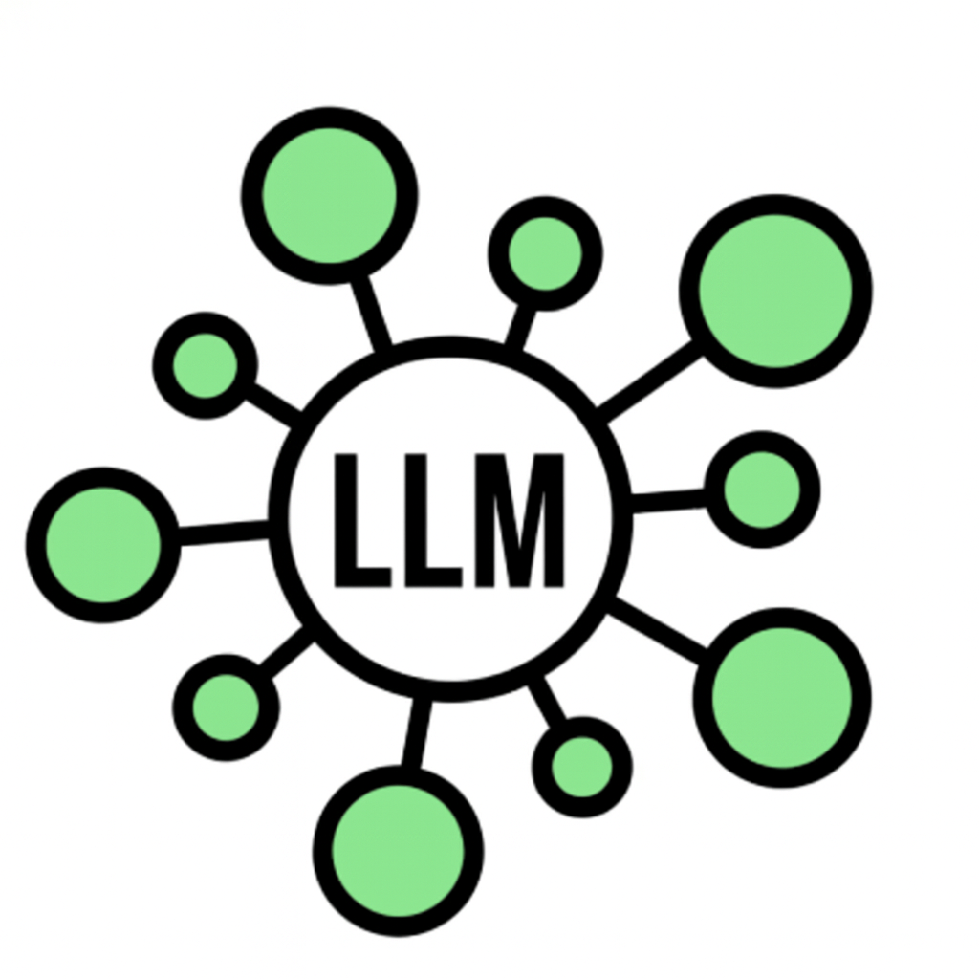
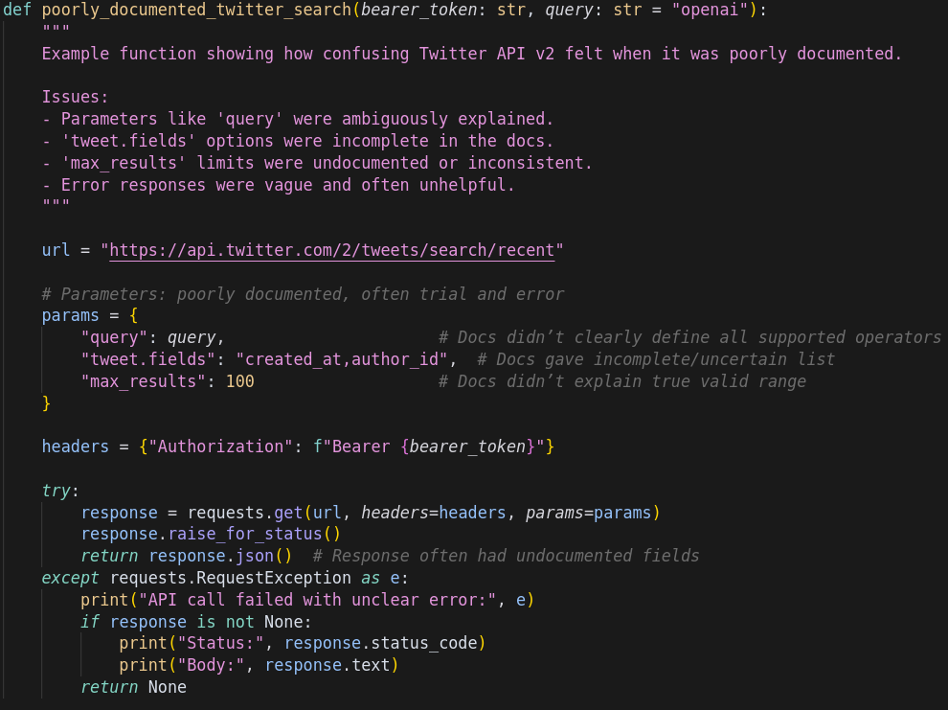


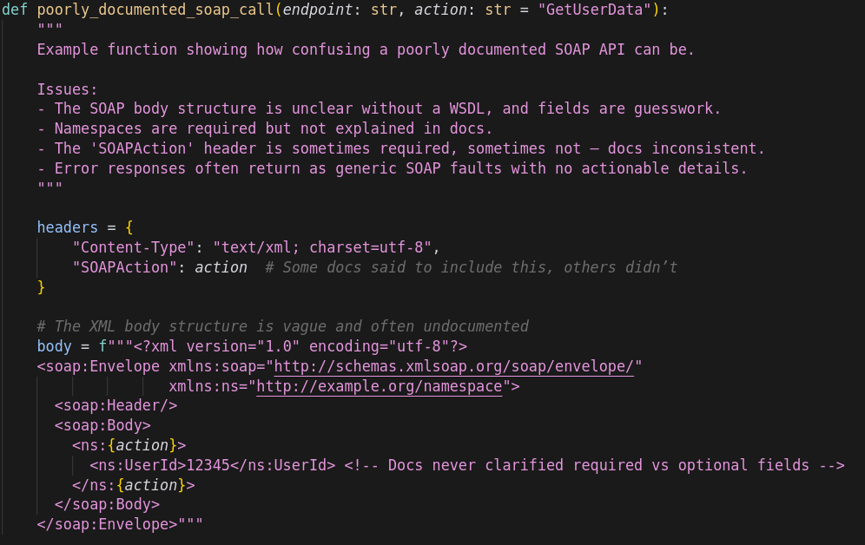
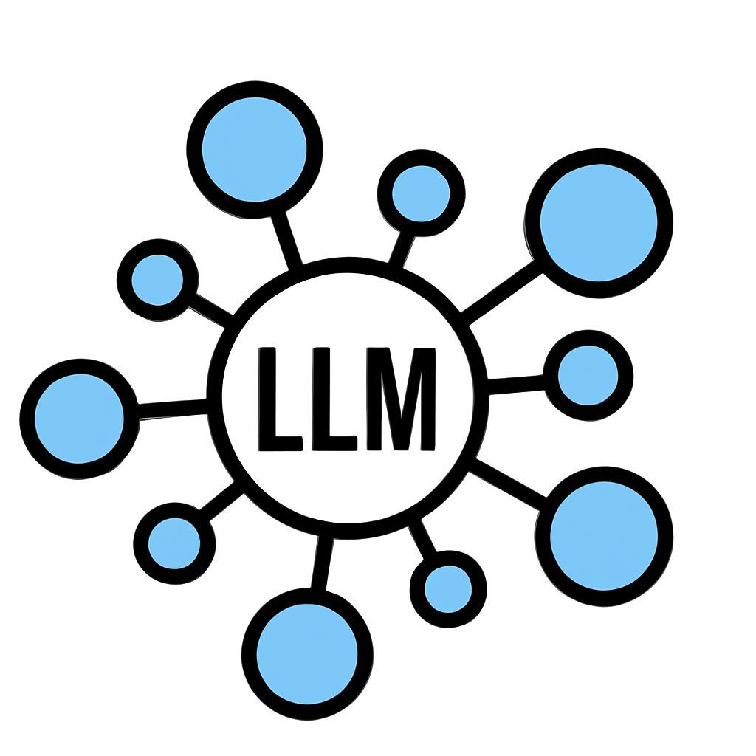

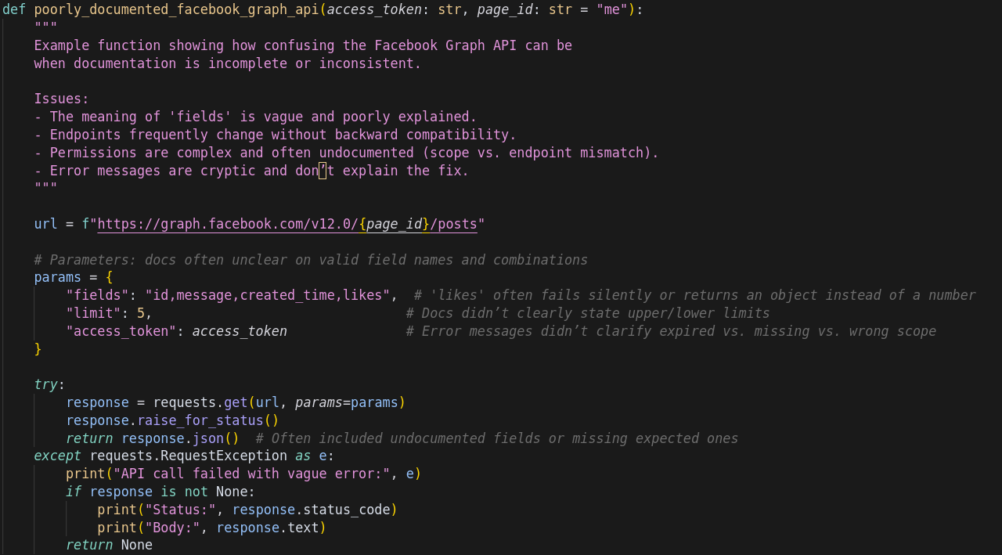
Originally
themodernsoftware.dev
Notes:
Separate connector for each LLM -> API

Slide 8
Now with MCP
MCP
themodernsoftware.dev

Slide 9
MCP A Bit Deeper
Terminology
  Host: Cursor, Claude Desktop
  MCP Client: Library embedded on host (stateful session per server)
  MCP Server: Lightweight wrapper in front of a tool
  Tool: Callable function (could be data source, API)
Flow
  Client calls tools/list to MCP server (what can you do?)
  Server returns JSON describing each tool (name, summary, JSON schema)
  Host injects that JSON into model’s context
  User prompt triggers model, emitting a structured tool call
  MCP server executes and conversation resumes
MCP provides stdio and streamable HTTP transport layer
themodernsoftware.dev

Slide 10

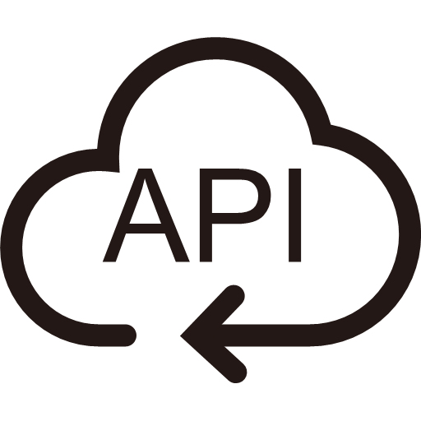



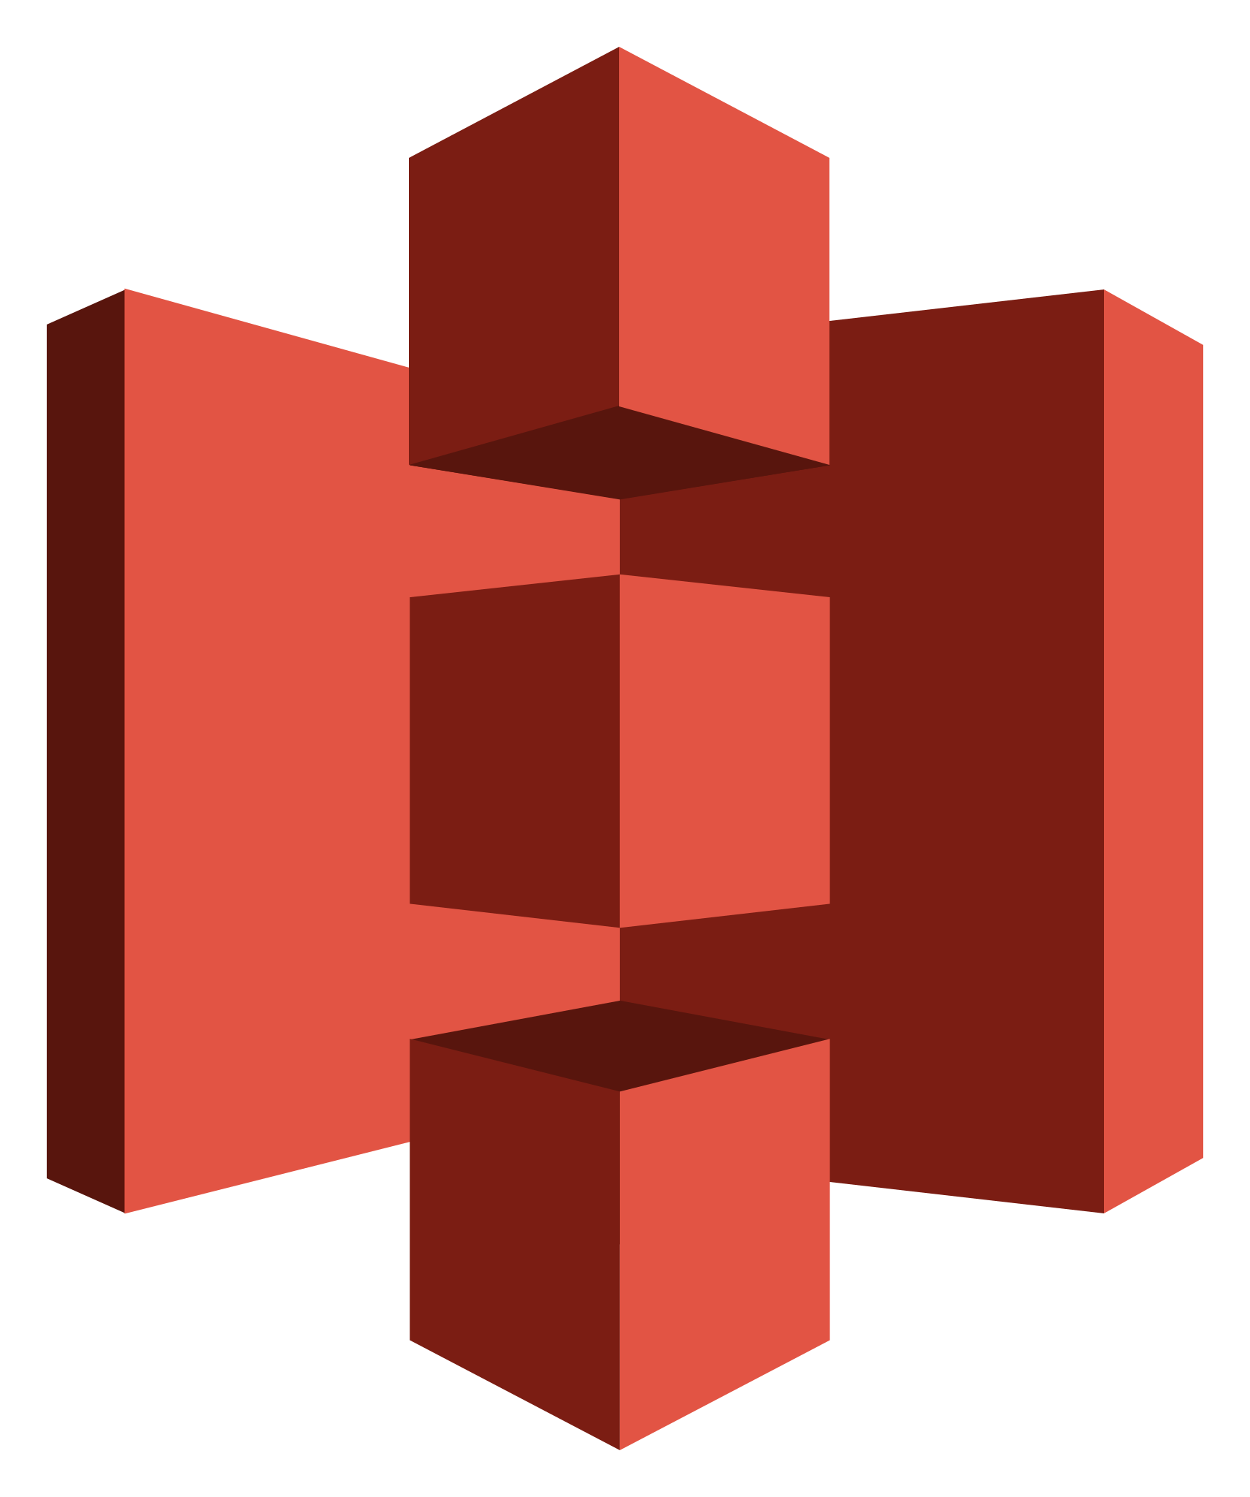


MCP client
MCP server
2
Summarize my emails from Jack
Get tools
1
Ask query
5
4
Send response
Call function for tool and get response
3
Send query and pick tool with params
themodernsoftware.dev

Slide 11
How to design a good MCP server (Option 1)
MCP is not a REST API wrapper
  Too many small tools
  Large, complex contexts
  Agents spend too much time orchestrating logic
Best practices
  Design for outcomes not operations
    send_payment(user_email) NOT get_users(user_id) → list_account(user_email) → send_payment(account_id)
  Explicit arguments
    Not nested dict inputs
  Instructions are context
    Docstrings, error messages, etc are prompts
  Name tools for discovery
    Service-prefixed tool names
themodernsoftware.dev

Slide 12
How to design a good MCP server (Option 2)
As # of MCP servers explode, only expose two tools: search and execute
Agent calls search to find relevant tools and definitions
Execute generates deterministic code to perform an operation
Massive context reduction and approach is agnostic of how many MCP servers there are
90+% token reduction
themodernsoftware.dev
Notes:
Load tools on demand, filter data before it reaches the model, and execute complex logic in a simple step

Slide 13
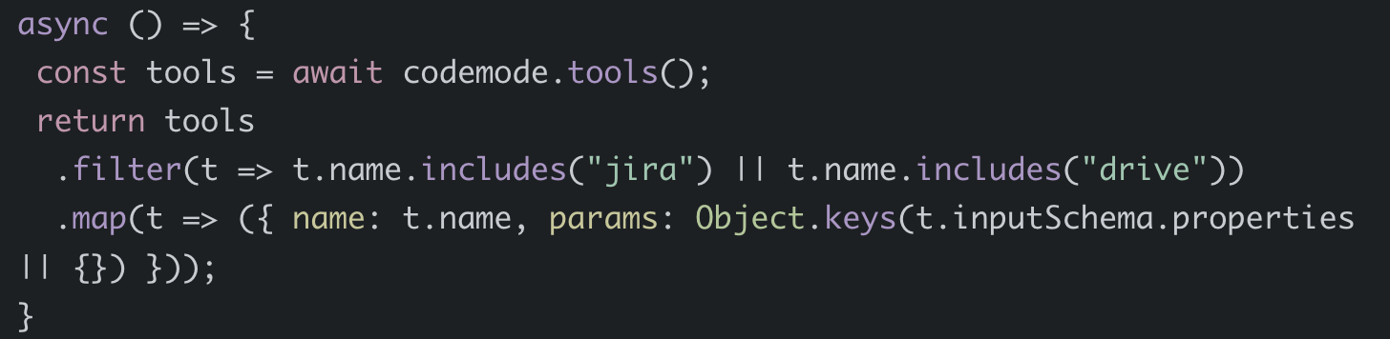
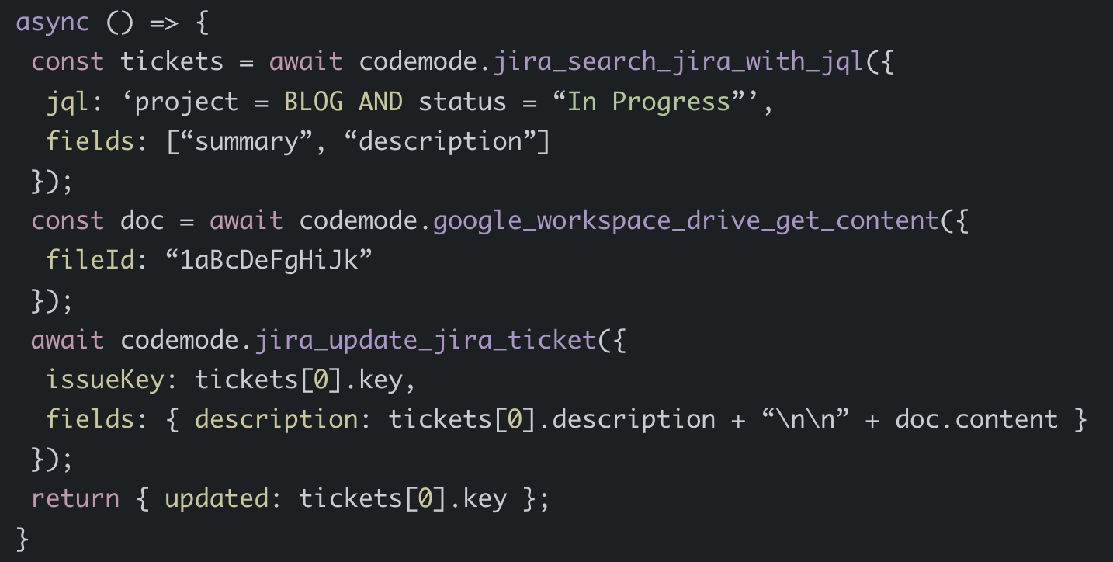
How to design a good MCP server (Option 2)
Find a Jira ticket and update with info from Google drive
themodernsoftware.dev
Notes:
Load tools on demand, filter data before it reaches the odel, and execute complex logic in a simple step

Slide 14
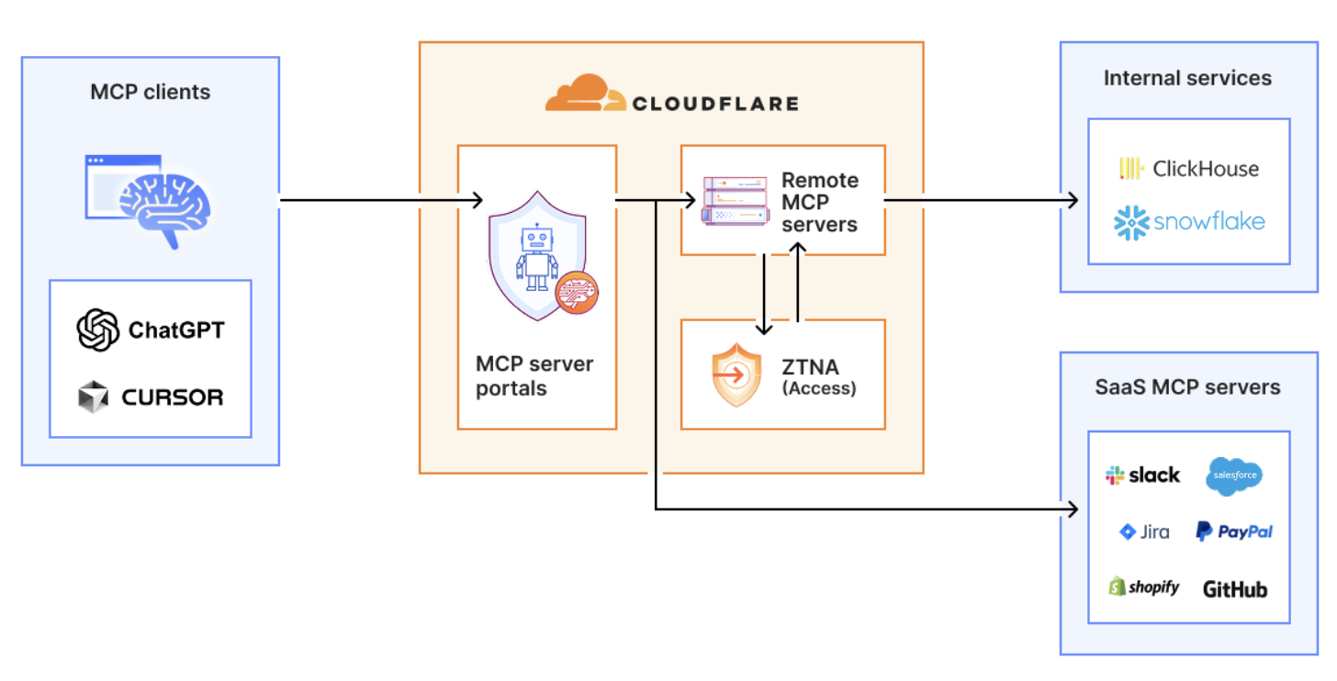
Advanced MCP Architecture Design
themodernsoftware.dev
Notes:
The employee simply connects their MCP client to the MCP server portal, and the portal immediately reveals every internal and third-party MCP servers they are authorized to use.
Beyond this, our MCP server portals provide centralized logging, consistent policy enforcement and data loss prevention guardrails

Slide 15
Agent Skills
A standard for dynamically loaded agent capabilities
  Domain-specific
  Combine code and prompts
  Loaded by agent as needed
Use cases
  Document authoring
  Powerpoint creation
  Data analysis
  …and more
themodernsoftware.dev
Notes:
https://agentskills.io/home

Slide 16
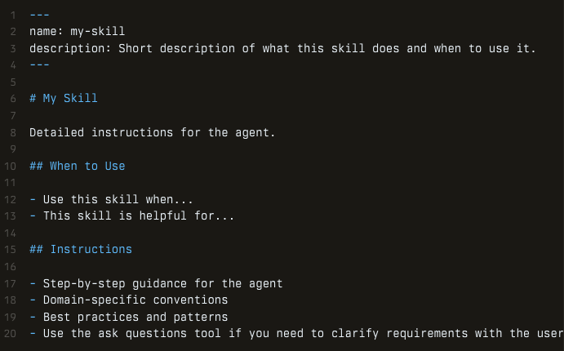
Agent Skills
themodernsoftware.dev
Notes:
Provide a skills.md
Show example of gws agent skills: https://github.com/mattpocock/skills

Slide 17
APIs vs MCP vs Skills
APIs
  What: HTTP/REST/GraphQL service interfaces exposed by app for developers to call
  Who: You call or an SDK
  Usage: You decide auth, retries, paginations, input validation, etc
MCP
  What: Tool definitions exposed by a server so an LLM agent can invoke them in a standardized way
  Who: model/agent runtime (as “tool calls”), not a human developer writing bespoke integrations each time
  Usage: Main mechanism for interacting with external resources, data, services
Skills
  What: Reusable task packages / procedures that teach an agent how to do a job, often by orchestrating multiple tools/endpoints
  Who: Agent or agent framework as higher level capability it can reach for
  Usage: Workflow abstraction - “here’s the repeatable way to complete X.”
themodernsoftware.dev

